Slide 1

Core Competence as a Strategic Tool for Sustainability of Business
21st March, 2025

Slide 2


Slide 3
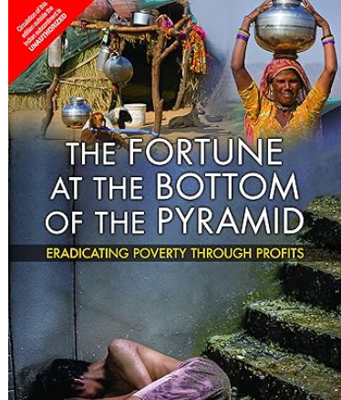

Slide 4
Core Competence
In simpler terms, it refers to the unique strengths or capabilities that a company possesses, which:
  Provide customer value.
  Are difficult for competitors to imitate.
  Can be leveraged to enter a wide variety of markets.

Slide 5

Core Competence
The concept was first introduced by C.K. Prahalad and Gary Hamel in their influential 1990 Harvard Business Review article, "The Core Competence of the Corporation"

Slide 6
Core Competence
Honda’s Engine Technology:
  Honda's core competence is in engine and powertrain technology.
  This competence allowed Honda to diversify from motorcycles to cars, lawnmowers, and even power generators.
Sony’s Miniaturization Technology:
  Sony's expertise in miniaturization enabled the creation of compact and high-quality products like the Walkman and compact cameras.
3M’s Adhesive and Coating Technology:
  The ability to develop adhesives and coatings led to innovations like Post-it Notes and a wide range of industrial products.

Slide 7

Culture as Core Competence
Core Competence: Employee-First Culture
MTR’s philosophy revolves around prioritizing the well-being and satisfaction of its employees. This approach not only ensures a high level of dedication and loyalty among the staff but also translates into consistent quality and hospitality, which are hallmarks of the brand.
Free Meals for Employees:

Slide 8
Core Competence – Low Cost Advantage
Ryanair
  Core Competence: Ultra-low-cost air travel.
Walmart
  Core Competence: Cost leadership and efficient supply chain management.
  Everyday Low Price

Slide 9
Core competence – Leading to failure
Nokia
  Core competence: high quality mobile hardware
  Reason for Failure: Nokia’s focus on hardware excellence and traditional mobile phones made it slow to adapt to the software-centric smartphone revolution led by Apple and Android.
Kodak
  Core Competence: Film photography and image technology
  Reason for failure: Kodak was highly skilled in film production and imaging but became too rigid in its mindset. It was overly committed to its film-based business model and underestimated the rapid rise of digital photography.

Slide 10
Core Competence and Sustainability of Business
Competitive Advantage and Differentiation
Core competence allows a business to differentiate itself from competitors by offering something uniquely valuable. This differentiation can sustain long-term market leadership.
Example:
  Apple: Combines design excellence and seamless hardware-software integration as core competencies. This unique blend makes Apple products stand out, fostering brand loyalty and premium pricing.
  Sustainability: Competitors struggle to replicate the same level of design and user experience, keeping Apple ahead in the tech market.

Slide 11


